Slide 1
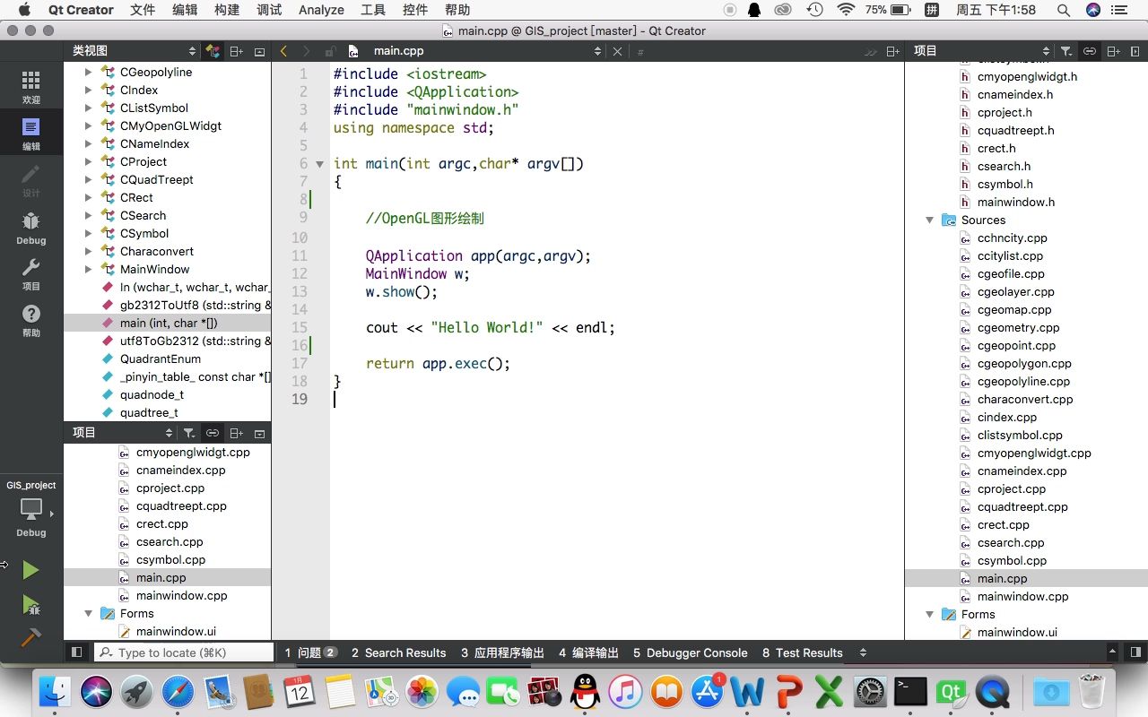
7_2015301110036_刘子煜

